Slide 1
VECTOR SPACE
NAZMUL KADER CHOWDHURY

Slide 2
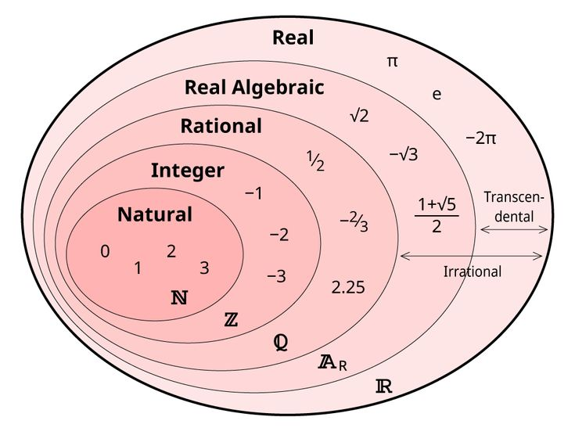


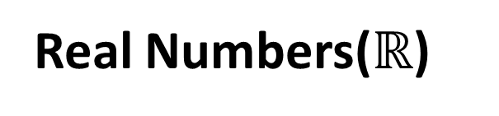
basic number sets
Natural Numbers ($ℕ)$
Also called counting numbers
Example {1,2,3,4,…….}
These are the numbers we first learn as kids — we use them to count fingers, apples, or steps.
Integers ($ℤ$)
Includes positive and negative whole numbers
Example
{………-4,-3,-2,-1,0,1,2,3,…………..}
Real Numbers($ℝ$)
All rational + irrational numbers
Includes: fractions, decimals, whole numbers, negatives, etc.

Slide 3


Slide 4

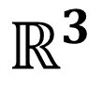
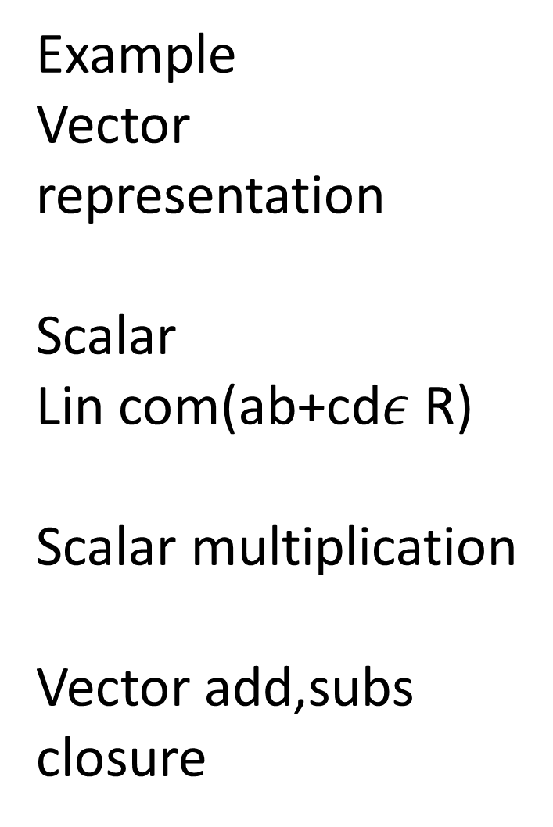

Example
Vector representation
Scalar
Lin com(ab+cd$ε$ R)
Scalar multiplication
Vector add,subs
closure
$$ℝ$$
$$ℝ^{2}$$
$$ℝ^{3}$$

Slide 5

Axioms:
An axiom is a basic rule or starting point that we accept as true without needing to prove it.

Slide 6
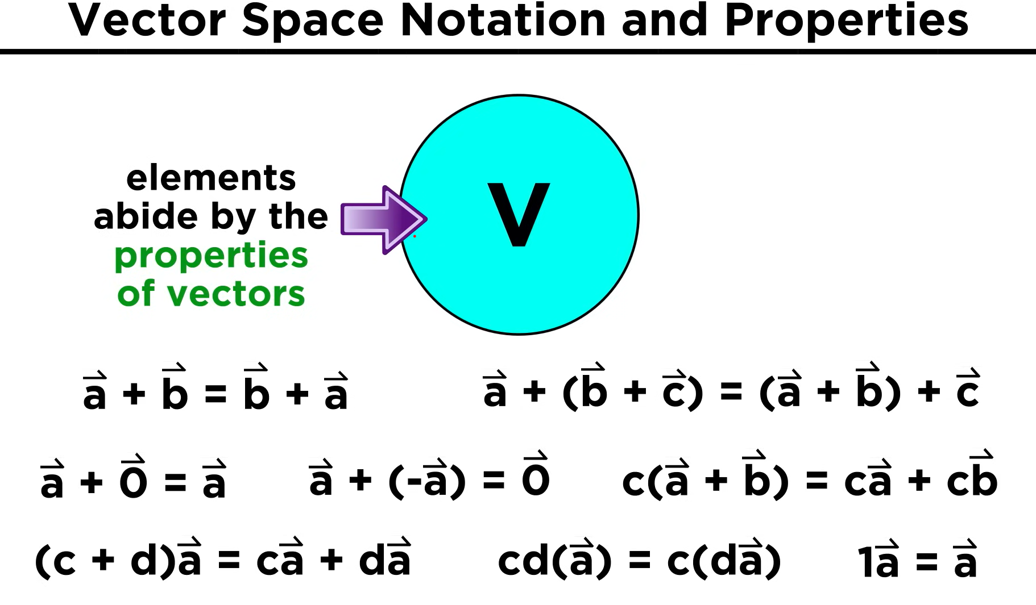

Slide 7
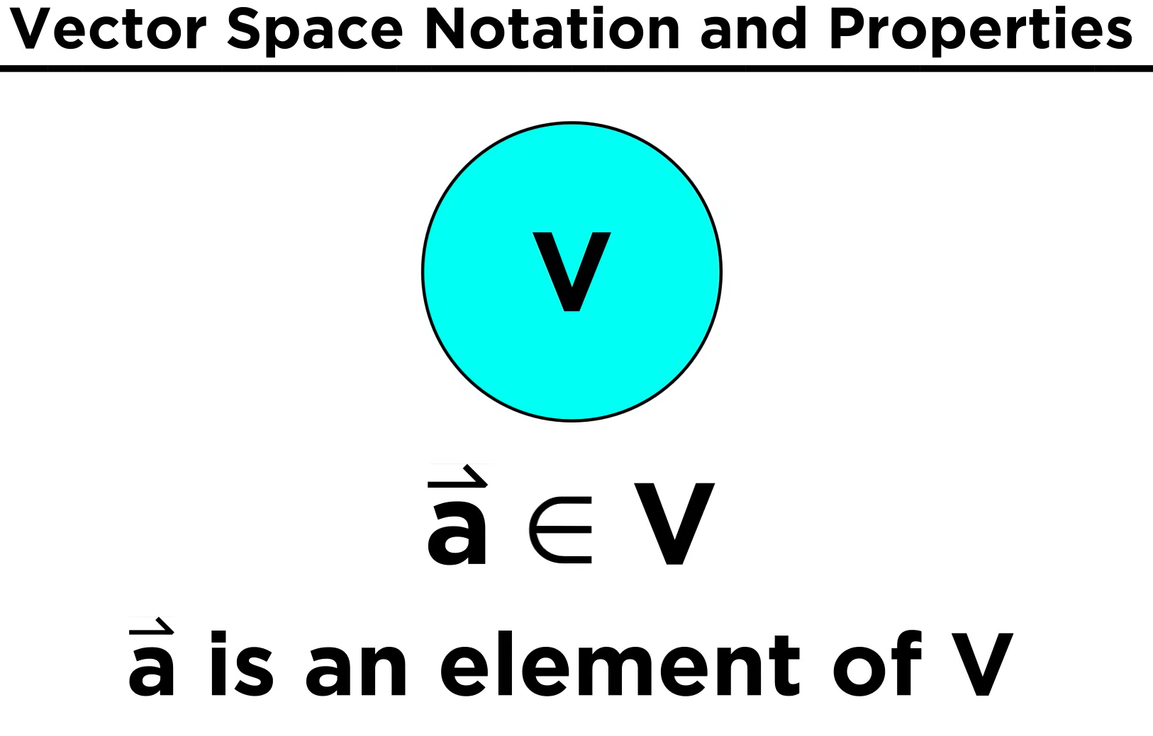

Slide 8
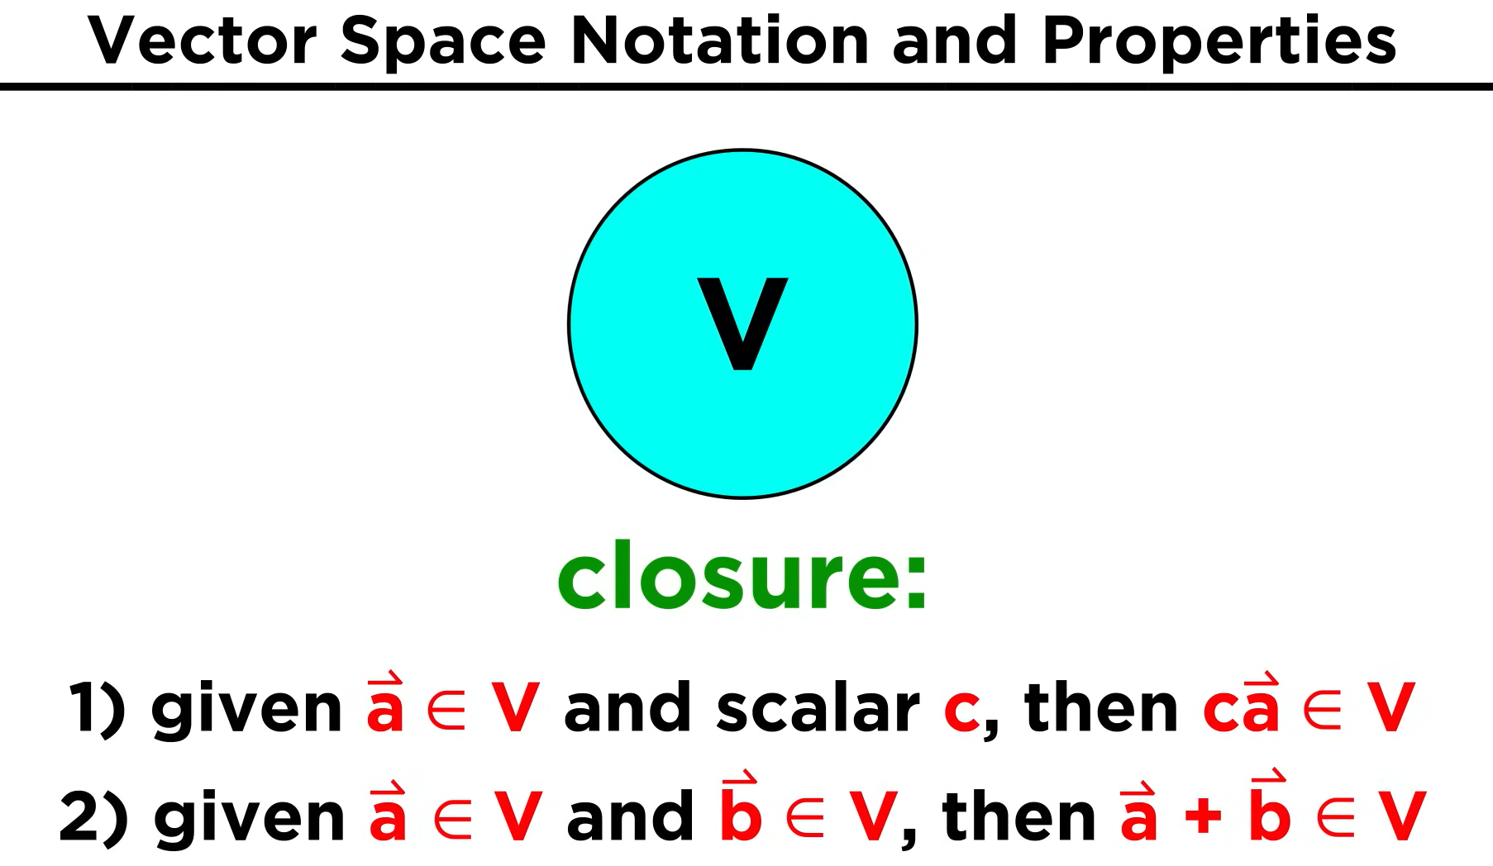

Slide 9
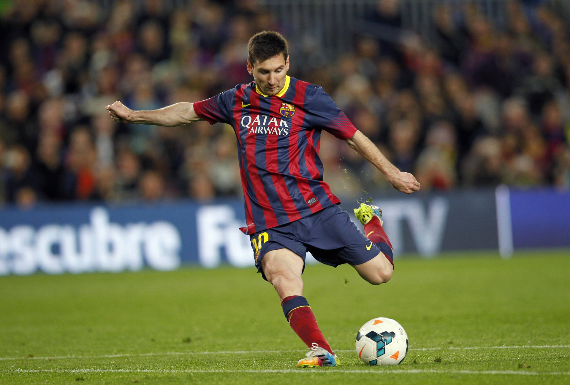
Vector space
Player: Messi
The actions = passing and shooting
The rules = Long pass, short Pass, Dribble, Bicycle kick, Volley, Half volley etc

Slide 10
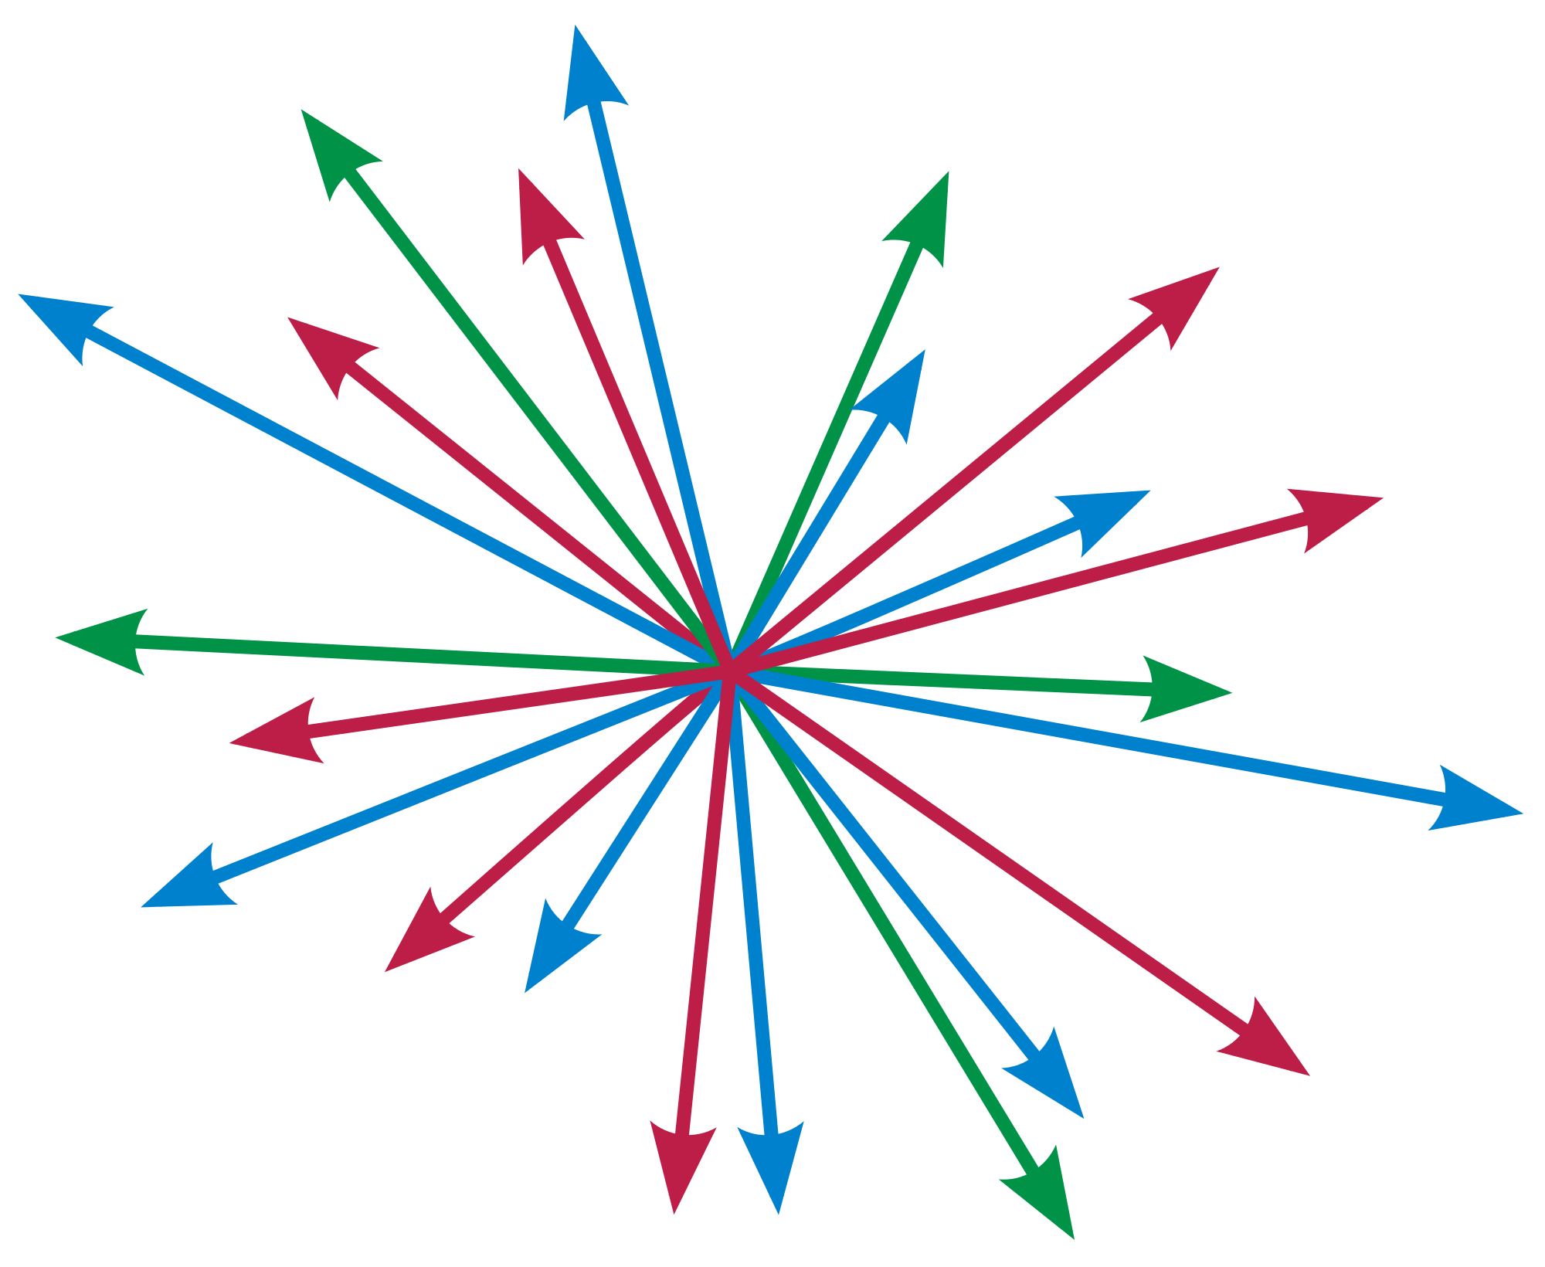
Player: Vectors
The actions = addition and scalar multiplication
The rules = the 8 axioms( associativity, distributivity, existence of zero vector, etc)

Slide 11
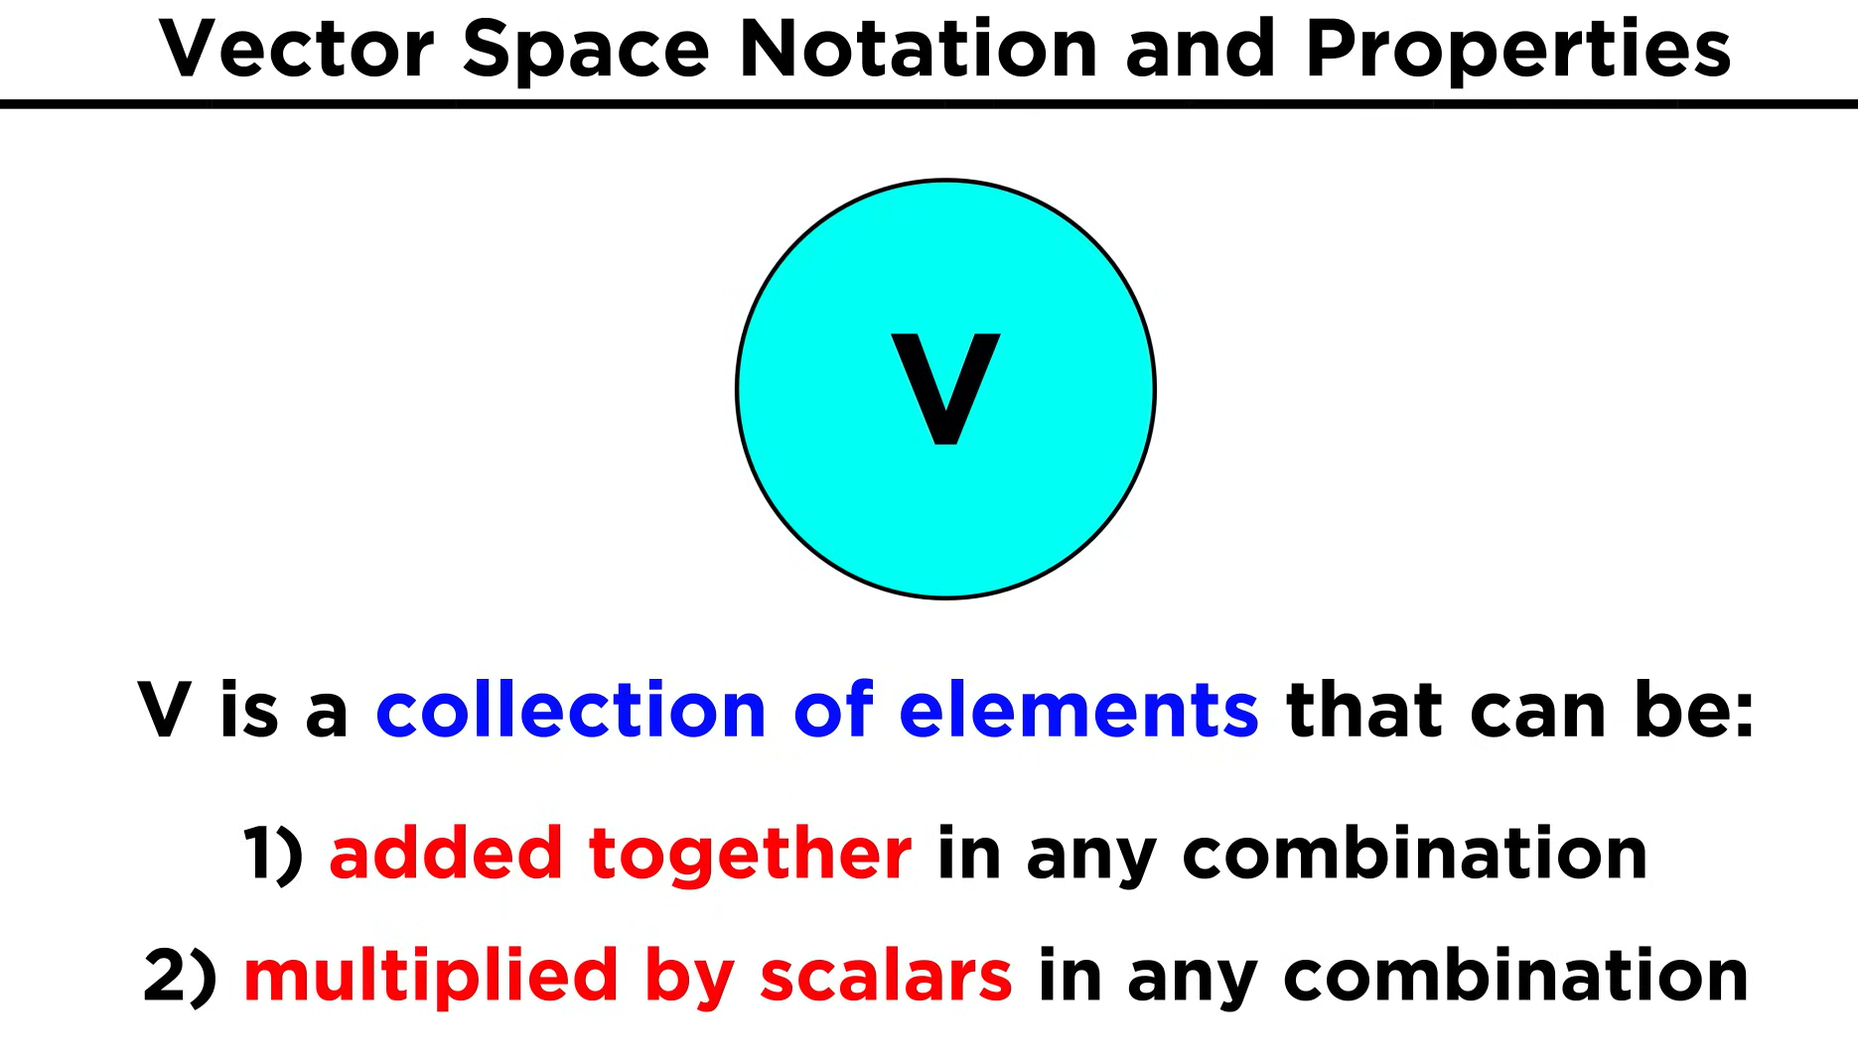

Slide 12
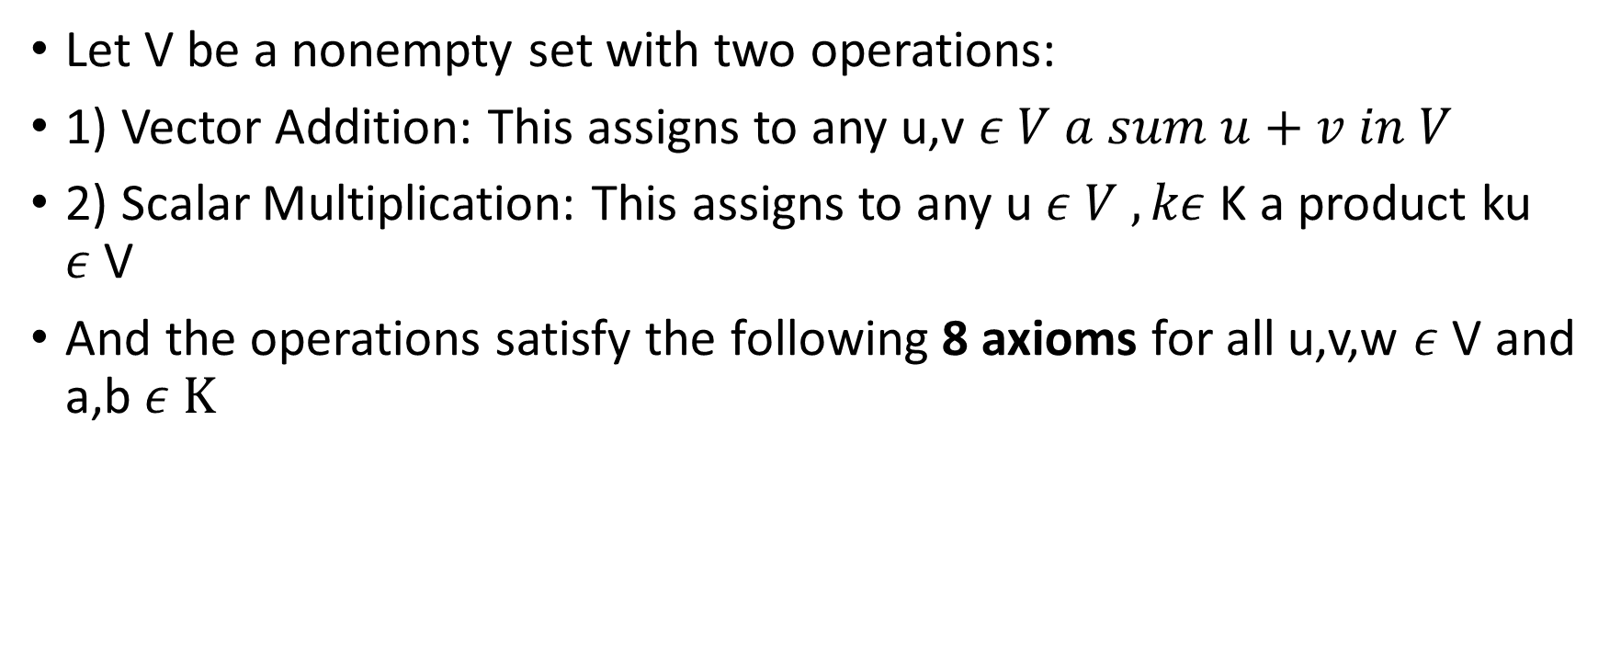
What is Vector Space?
Let V be a nonempty set with two operations:
1) Vector Addition: This assigns to any u,v $ε V a sum u+v in V$
2) Scalar Multiplication: This assigns to any u $ε V , kε$ K a product ku $ε$V
And the operations satisfy the following 8 axioms for all u,v,w $ε$ V and a,b $ε K$

Slide 13
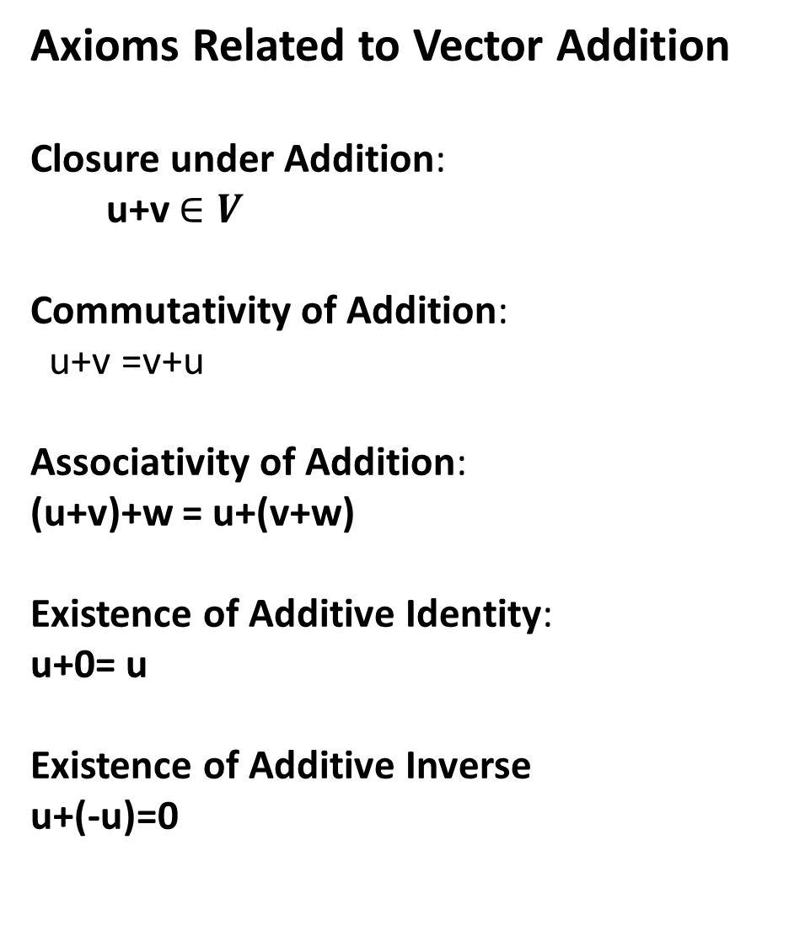
Axioms Related to Vector Addition
Closure under Addition:
u+v $∈V$
Commutativity of Addition:
u+v =v+u
Associativity of Addition:
(u+v)+w = u+(v+w)
Existence of Additive Identity:
u+0= u
Existence of Additive Inverse
u+(-u)=0

Slide 14
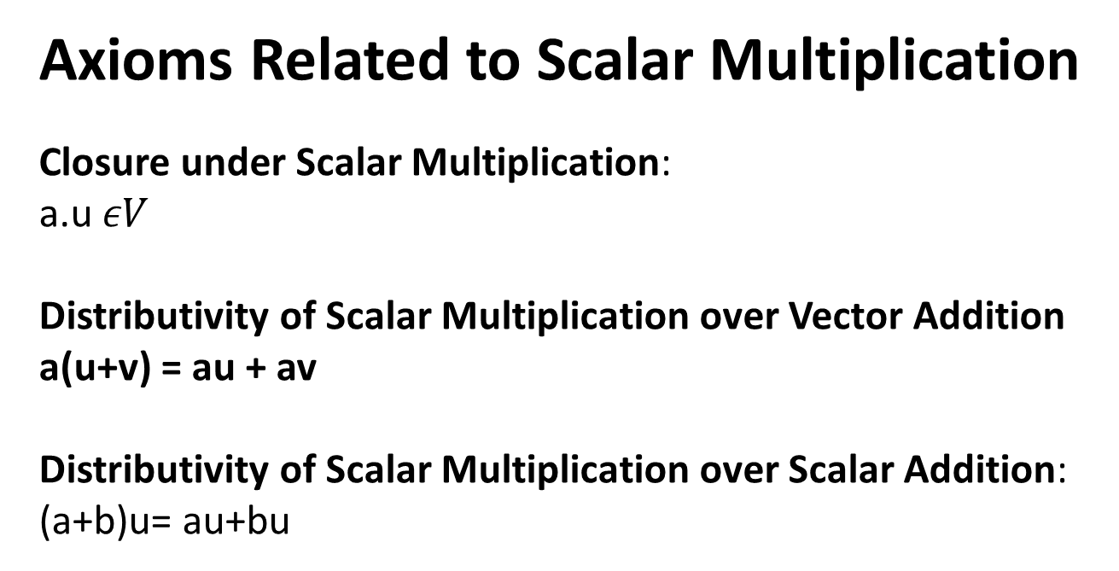
Axioms Related to Scalar Multiplication
Closure under Scalar Multiplication:
a.u $εV$
Distributivity of Scalar Multiplication over Vector Addition
a(u+v) = au + av
Distributivity of Scalar Multiplication over Scalar Addition:
(a+b)u= au+bu

Slide 15
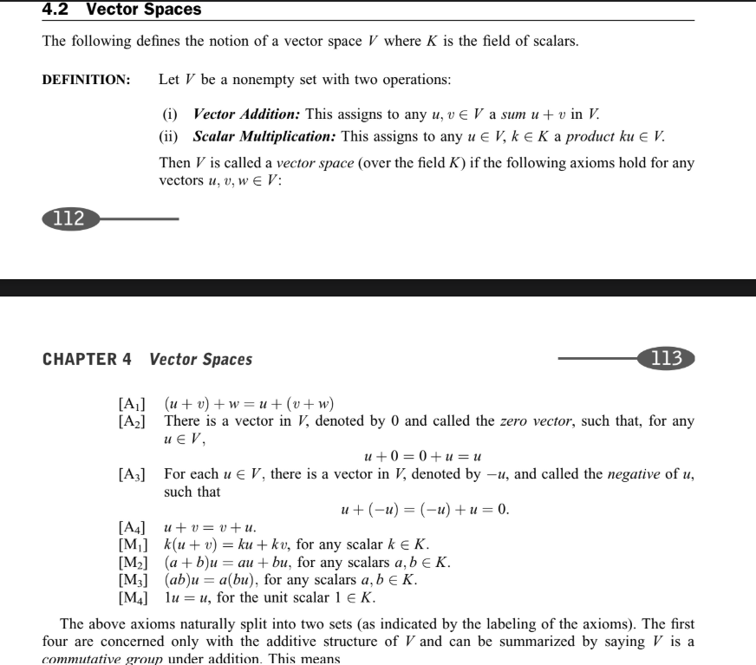

Slide 16
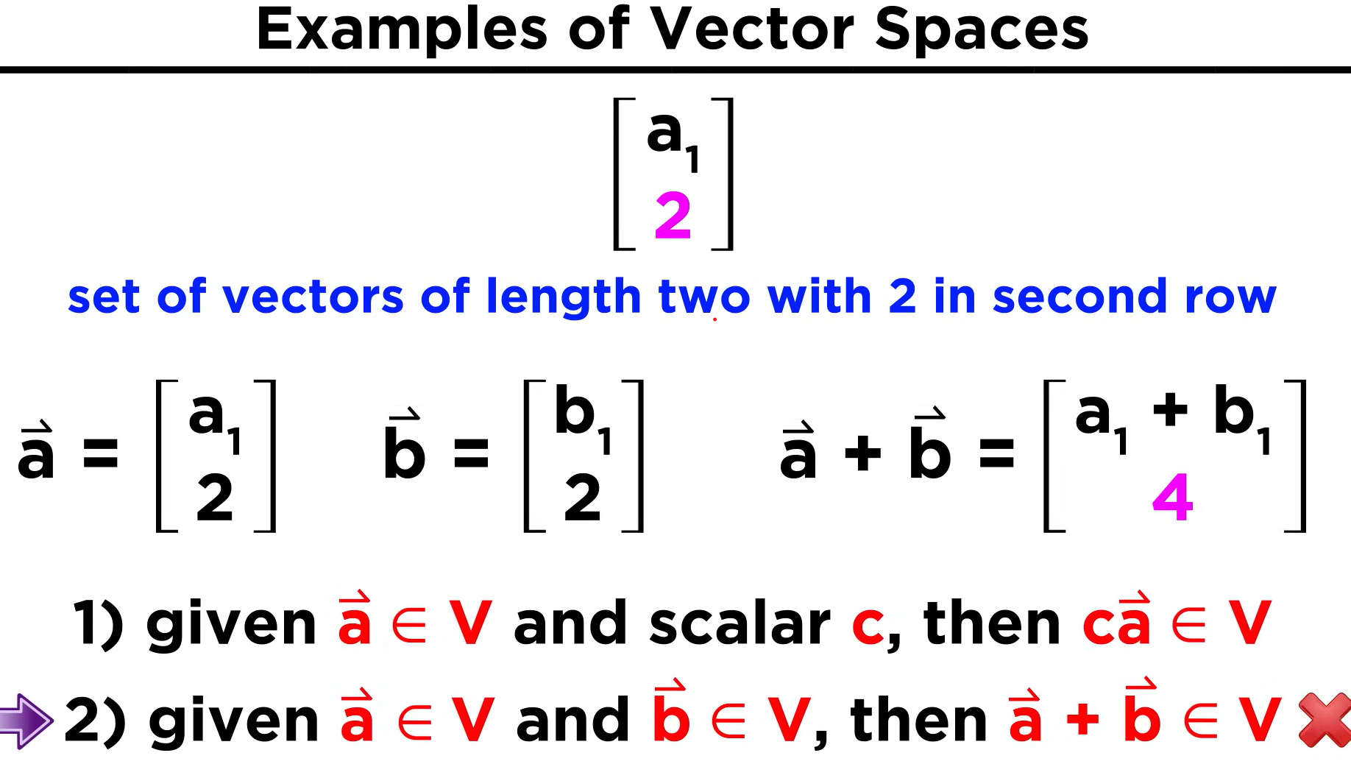
Example of Vector Space

Slide 17
Subspace
V
S

Slide 18
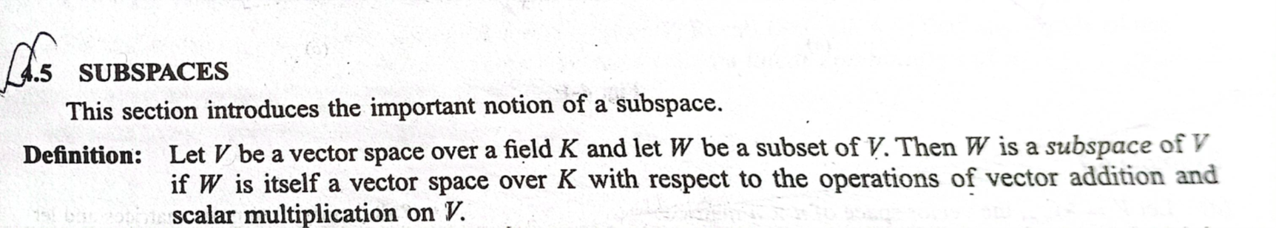

Slide 19
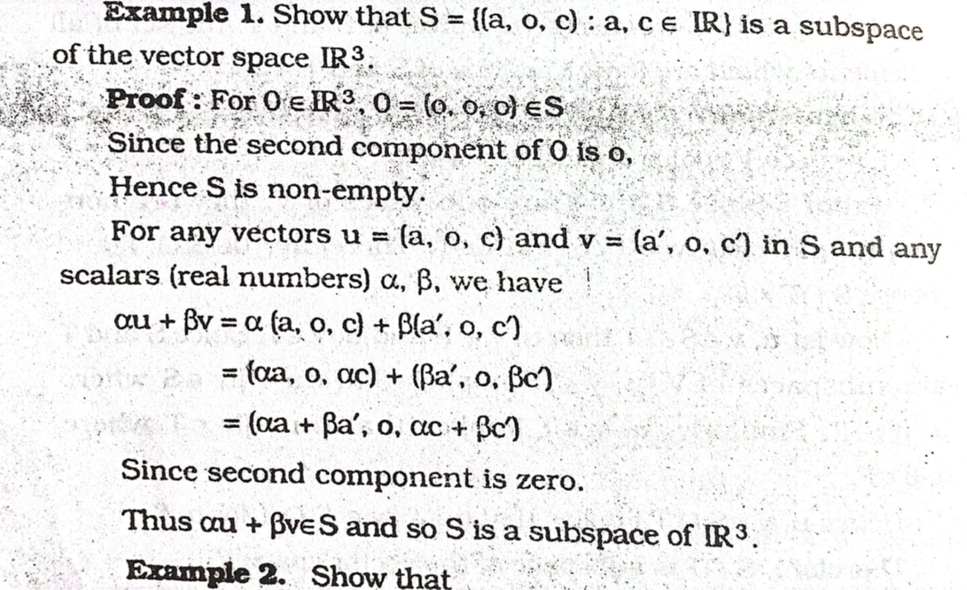

Slide 20
If V($ℝ$)={$\left(\begin{matrix}a & b \\ c & d\end{matrix}\right):a, b,c,d εℝ\} is a vector space. Show that w=\left\{\left(\begin{matrix}a & b \\ c & d\end{matrix}\right):\left|\begin{matrix}a & b \\ c & d\end{matrix}\right|=0\right\}is not a subspace of V$

